Slide 1

The Long life cycle of metals & re-cycling
Teachers involved:
English Teacher Abate Alessandra (Clil)
Science Teacher Bonfatti Elisabetta
Science Teacher Conti Franca
Art Teacher Cantelli Marco
Science Teacher Notaristefano Carmela

Slide 2
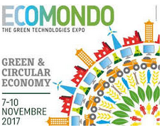
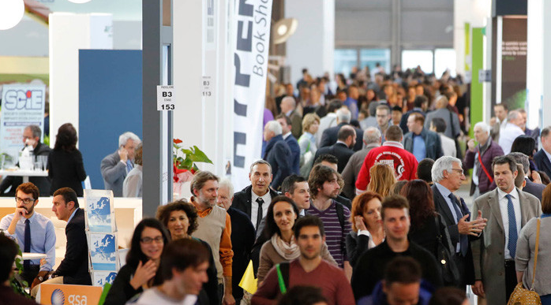
A new experience
Notes:
Mettere FOTO scattata ad ECOMONDO
Role 1: CALLEGARI
Hi, I’m Beatrice and I attend the first grade of Liceo Fermi
And in this picture I am with my classemates
Immagine su tutti i ragazzi che salutano → Hi !
Role 1 continues: CALLEGARI
In November, on (the) 8 th (of) November, our teachers took us to Ecomondo Fair which took place in Rimini
Role 2: BRUNI
Ecomondo is the leading green and circular economy expo within the Euro-Mediterranean area .
the main theme of the expo was:“energy for the climate”, that is to say energy-efficiency solutions & applications and renewable energy.
Role 3: CAMPOLI
Did you know that Italy is among the leading countries in Europe in the green and circular economy, in particular in energy efficiency, waste recycling and resource productivity.
For this reason, Ecomondo is a reference point in the international panorama, where all the leading companies of the sector can meet and discover the trends, innovations and new technologies and exchange views with sector professionals.
Role 4 BALLARINI
There we had the chance to participate to two interesting workshops. One was about chemistry and another one about metals.
we have learned a lot and we have the pleasure to share our know-how with you
So let’s start our journey in the world of metals !

Slide 3
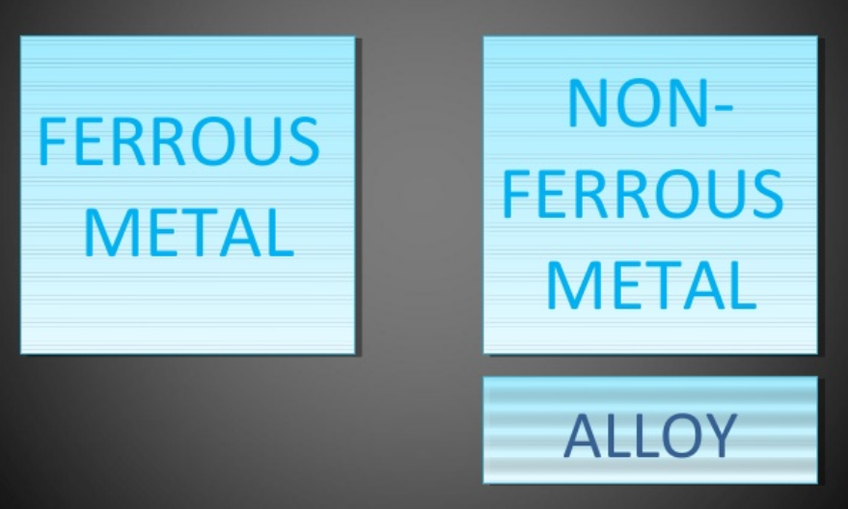
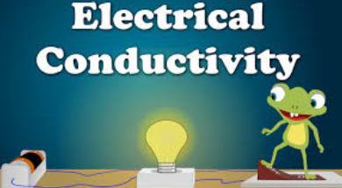

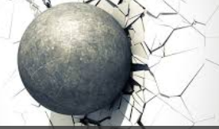
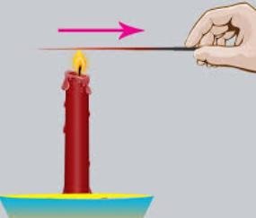
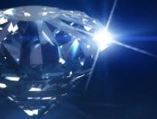
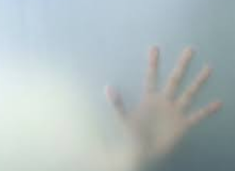
METALS
Notes:
Role 1 : BRUNI
Now let’s test your knowledge….Let’s see…
Do you know what metals are ?
And how many there are? (inquadrare i metalli)
Role 2 : LEONARDO ROSOLINI
A metal is a material that is typically hard when it is in its solid state, opaque, shiny, and has good electrical and thermal conductivity.
Role 1: BRUNI
you are a pure genius !!! You always know the answer !!

Slide 4
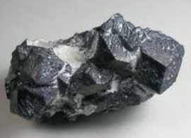
Types of metals
FERROUS METALS iron
NON FERROUS METALS NO iron
FERROUS ALLOYS 2 or more metals
Notes:
Role 3 : GIULIA CAMPOLI
Ehi, I know some more about metals :
Well, I know that METALS can be grouped in:
FERROUS METALS that is to say containing iron
and
NON FERROUS METALS that is to say without iron
As well as in :
FERROUS ALLOYS that ARE usually composed of 2 or more elements (metals)
Did you know that ALLOYS are usually used in MANIFACTURING ?
Role 5: CALLEGARI
FERROUS METALS ARE METALS THAT CONSIST MOSTLY OF IRON AND SMALL AMOUNTS OF OTHER ELEMENTS
Role 1: BRUNI
Well, well… here we are….. we have another genius in the group !

Slide 5
A practical example
Notes:
Role 1 BALLARINI
Now let’s show you with an experiment why we say that metals can be grouped in 2 main categories
(telecamera inquadra studente che prendere la calamita ed attira solo parte degli oggetti metallici)
Role 1: BALLARINI
As you can see the magnet has attracted only part of the objects and this is because they have ferrus inside !
So this proves that these objects (inquadrare gli altri oggetti non metallici) haven’t got any ferrus element, that isto say any iron.
Role 2: CALLEGARI
Correct ! ….Elementary ! My dear Mr Watson !!!

Slide 6
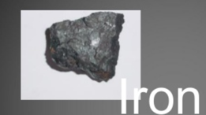
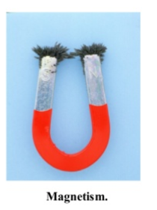
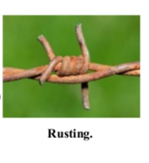

FERROUS METALS
Notes:
Role 1: BORTOLOTTI
So with this experiment we have demostrated that one of the main characteristic of ferrous metals is MAGNETISM.
As a matter of fact, Ferrous metals can be picked up by a magnet
Role 2: CAMPOLI
Well… Did you know that ferrous metals are also prone to rusting if exposed to moisture (umidità)?
Therefore we can say that Rusting and Magnetism are typical characteristics of Ferrous metals.
both characteristics re due to the presence of iron in them.
RUST = RUGGINE
RUSTING : Arrugginirsi

Slide 7
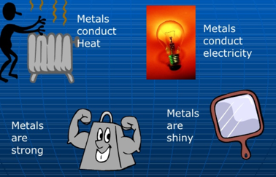
Properties of a metal
Notes:
Role 1: ROSOLINI
So let’s recap what are the properties of metals
Role 2: TONELLI
leggere la slide

Slide 8
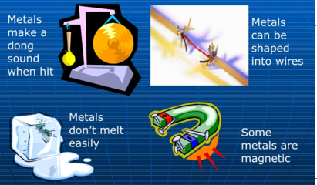
Notes:
Role 1: ROSOLINI
are there amy more properties of metals?
Role 2 : TONELLI
leggere la slide

Slide 9
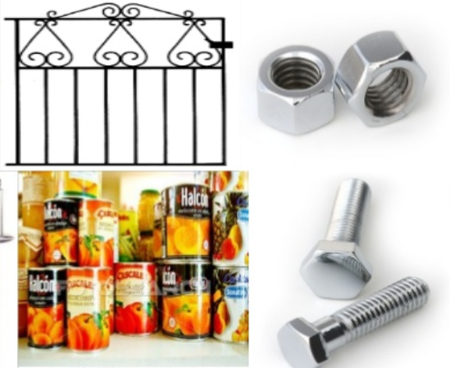
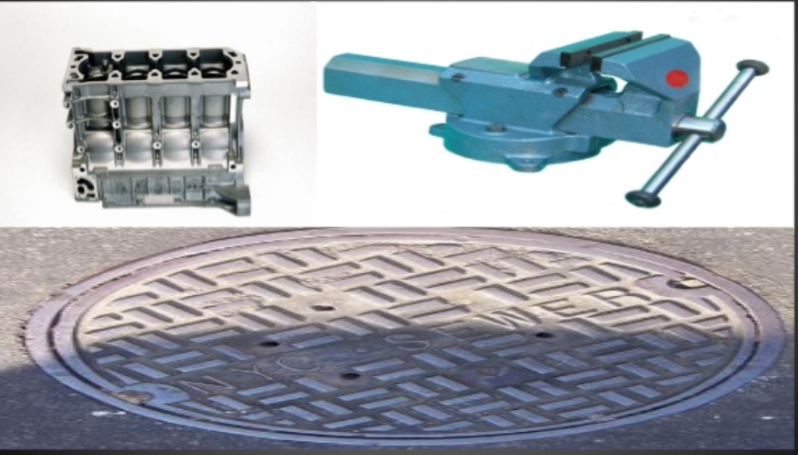
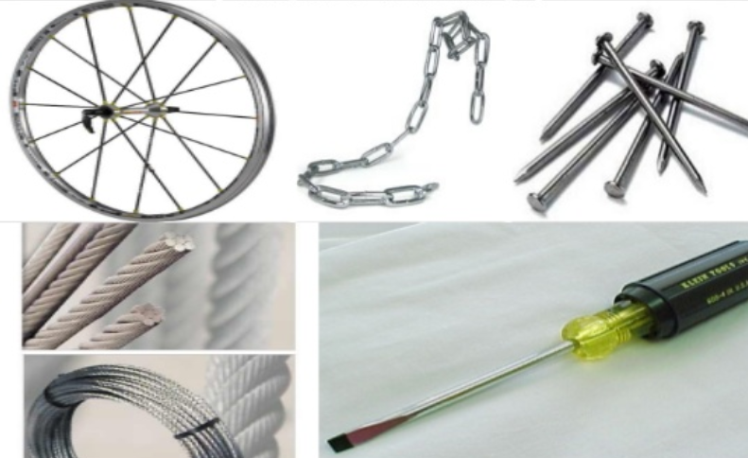
Low carbon steel
ferrous alloys
CAST IRON
Mild steel /
mEDIUM
CARBON STEEL
Notes:
Role 1: FANTI
Now let’s see in more details Ferrous Alloys
The ferrous alloys mostly contain Iron and they also have small amounts of other metals or elements added, to give the required properties.
They are mostly made of iron and small quatities of other metals.
Ferrous Alloys are magnetic and give little resistance to corrosion.
Ferrous Alloys include
mild steel, (medium carbon steel)
carbon steel,
stainless steel,
cast iron,
and wrought iron.
In this slide you can see the most common objects made of iron-carbon alloys that is to say : iron + carbon metal.

Slide 10
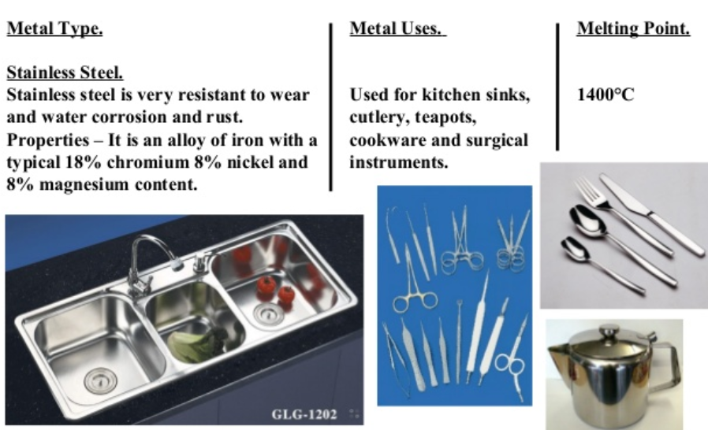
Ferrous alloy : Stainless steel
Notes:
Role 1 ALISHBA
Stailnless steel is the most well known metal alloy used by millions of people
Cutlery, sinks are all made of steel which is a ferrous alloy
Role 2 SARAH
This alloy has great properties: it does not moisturize (opacizza), doesn’t wear (graffiare), it’s easy to clean and shines like a mirror
This is the reason why my mum likes her stainless still so much
Stainless stell – acciaio inossidabile
To wear – graffiare

Slide 11
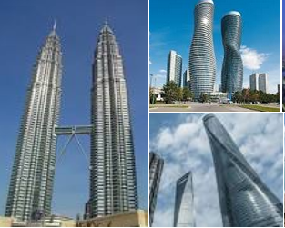
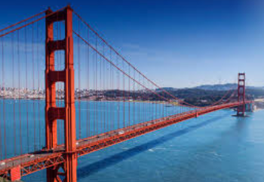
Ferrous alloy: Mild steel
skyscrapers
bridges
Notes:
Role 1 FOLI
Mild Steel which is a ferrous alloy is primarily used for its tensile strength and durability.
Therefore mild steel is used to build the tallest skyscrapers and the longest bridges in the world.
Role 2 MARTINO
ferrous metals as Mild steel is used in housing construction, industrial containers, large-scale piping, automobiles, rails for railroad and transportation, most of tools and hardware you use around the house, and the knives you cook with at home.

Slide 12
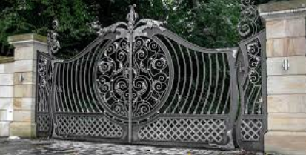
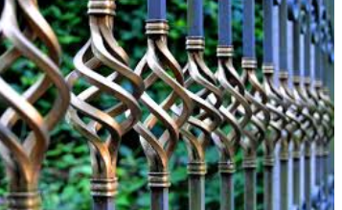
Ferrous alloy: wrought iron
gates
Notes:
Role 1 GALAZZI
Most of our gates are made of wrought iron which is a ferrous alloy

Slide 13
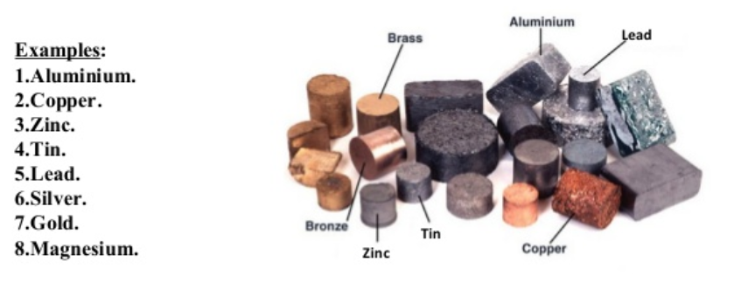
Non ferrous metals
Notes:
Role 1: ALISHBA
Now let’s see focus on non-ferrous metals
Non-Ferrous Metals do not contain Iron at all, are not magnetic and are usually more resistant to corrosion than ferrous metals.
This means that non ferrous metals, such as a tin….(.inquadrare gli oggetti rimasti sul tavolo non attratti dalla calamita mentre lo studente elenca i vari metalli non verrosi) Do not RUST !!
Role 2: SARAH
Non-ferrous metals include aluminum, brass, copper, nickel, tin, lead, and zinc, as well as precious metals like gold and silver.

Slide 14
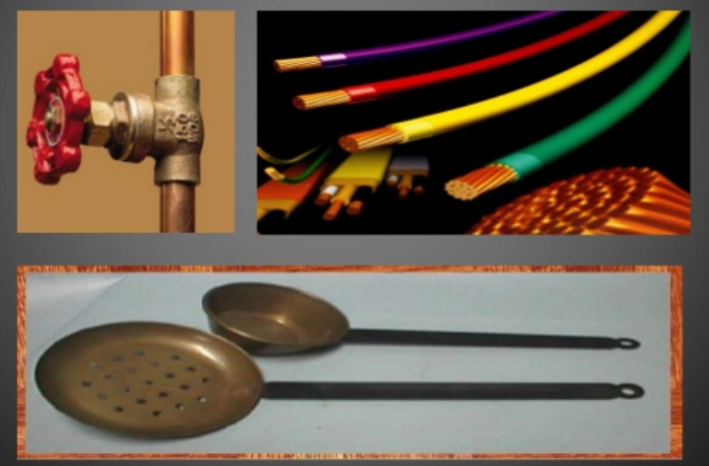
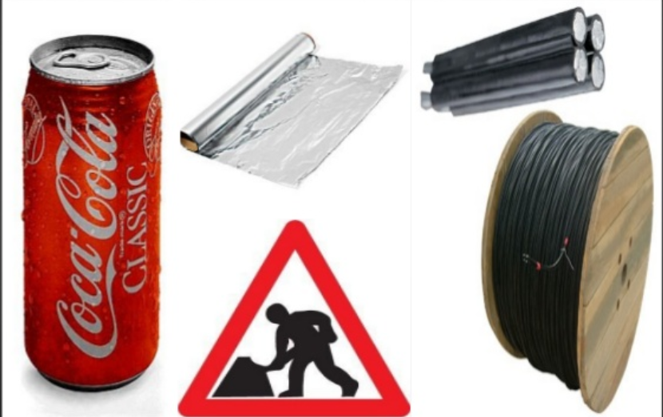
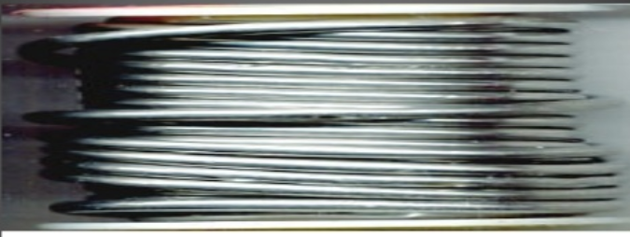
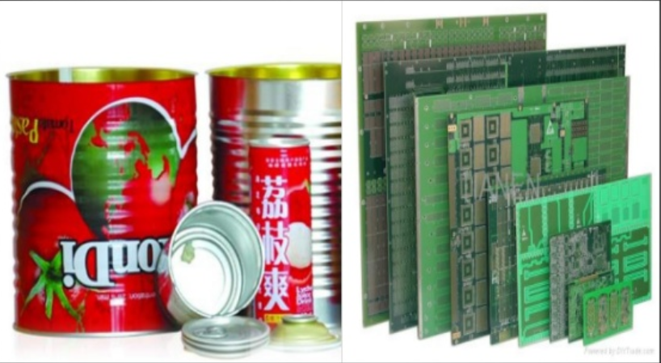
NON FERROUS METALS
COPPER
LEAD
TIN
Notes:
Role 1: GALAZZI
The most common non ferrous metals are used to make cans, or aluminium rolls or street signs
Role 2 GALEOTTI
To summarize the characteristics of non-ferrous metals we can say that they are much more malleable than ferrous metals. (stritolare una lattina tra le mani)
Non-ferrous metals are also much lighter,(lanciare la lattina per mostrare la leggerezza) making them well-suited for use where strength is needed, but weight is a factor, such as in the aircraft or canning industries.
Due to the fact that they contain no iron, non-ferrous metals have a higher resistance to rust and corrosion, which is why you’ll find these materials in use for gutters, water pipes, roofing, and road signs.
lessico
Copper – rame
Tin – stagno
Lead - piombo

Slide 15
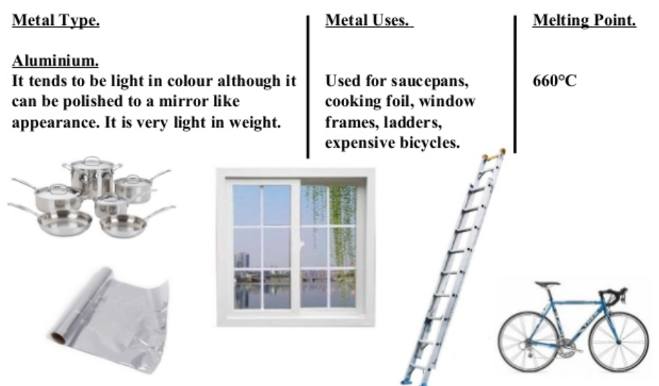
Non ferrrous metal: aluminium
Italy is among the top countries for recycling aluminium
90% of aluminium objects inour country is made of recycled aluminium
95% of energy saving
Notes:
Role 1 ELIA
Aluminium is a non ferrous metal and is extensively used.
Aluminium doesn’t contain iron therefore it is very shiny and light in weight (studente fa vedere un oggetto di alluminio)
It’s also non-magnetic, which makes it perfect for use in small electronics and as electrical wiring.
It’s extremely malleable, infact it can be found in the thinnest shields
Role 2 (Characteristics) FOLI
Thanks to its special properties and its high strength/weight ratio, aluminium has many applications, its implementation is in a constant growth.
Role 3 CAMPOLI VERONICA
the AREAS OF IMPLEMENTATION of aluminium are: Building / Transport / Mechanical Engineering / Electronics /Domestic Sector
Role 4 CARASSITI
As far as recycling goes, aluminum is the third most recycled material in the world, just like copper, brass and lead which are quite scarce
https://www.youtube.com/watch?v=yn9qhQSMCRk
http://www.altonmaterials.com/the-differences-between-ferrous-and-non-ferrous-scrap-metal/#.WmteuedG0aE

Slide 16
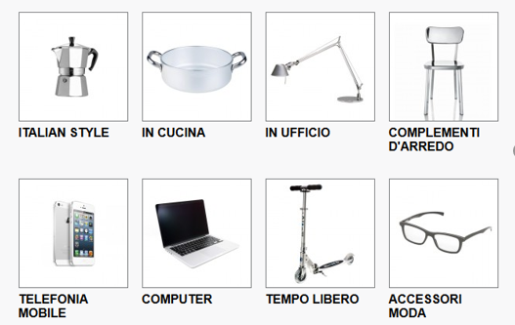
Most common aluminium objects
Notes:
Role 1 GALEOTTI
These are other objects made with aluminium

Slide 17
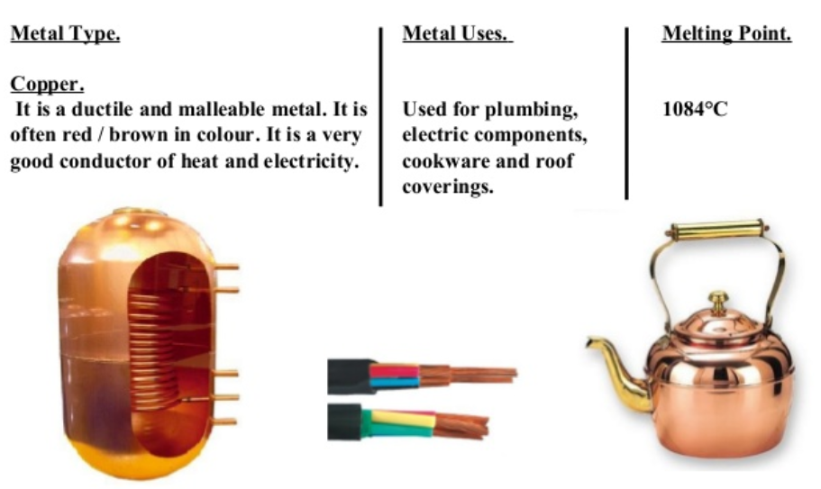
Non ferrous metal: copper
80% of copper extracted from mines is still in use today
At the end of their life cycle, all copper objects are collected, recycled, re-melted and re-made for any usage
Notes:
Role 1: ANGELO MA
copper is another non ferrous metal
The Romans gave copper its name.
Role 2: IACCARINO
According to archaeologists copper tubes for conveying water were first used in Ancient Egypt about the year 2750 BC.
Role 3: QUATTROCIOCCHI
There is an example in the Berlin State Museum taken from the temple near the pyramid of Sahure in Abusir.
Role 2: AZ
The fact that the copper piping is still present and fairly intact, in spite of the poor condition of the temple, speaks to the durability of copper as a piping material.
It’s used for producing alloys

Slide 18
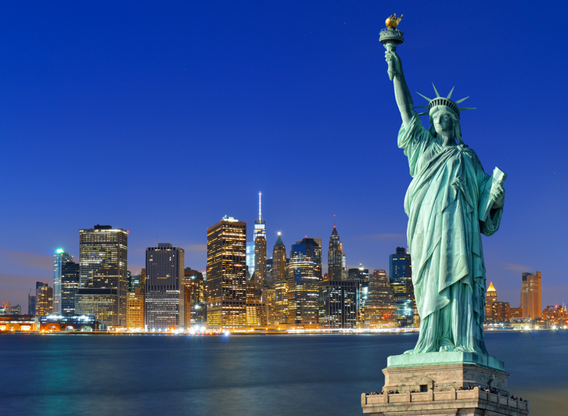
Copper – NEW YORK’ STATUE OF LIBERTY
Notes:
Role 1: AZ
Did you know that New York’s Statue of Liberty is made of more than 80 tonnes of copper that came from some Norway copper mines ? ??
It was fabricated (PUOI USARE ANCHE “MADE”) by French artisans.
At the times , Copper was an obvious choice because it (withstood) proved to be very resistant in the long journey from France to America
and resisted the salty sea it was exposed to.
Believe it or not…The natural, green patina on the Statue has protected her from corrosion since 1886 !!!!

Slide 19
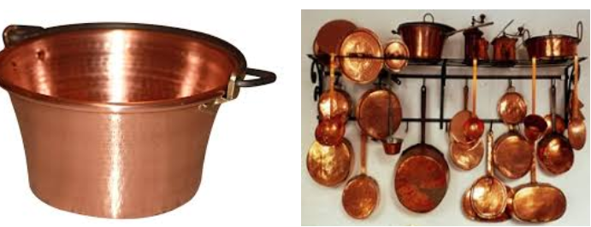
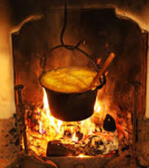
Copper COOKWARE
Notes:
Role 1: MINGHINI
From our grandmothers’ jam pans to the casseroles of the Michelin-starred chefs of the greatest restaurants, copper cookware is unrivalled.
Why?
Because copper is the best of any material used in cooking at conducting heat, guaranteeing a consistent, constant temperature and limiting thermal inertia.

Slide 20
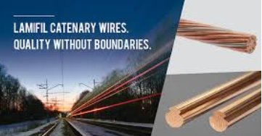
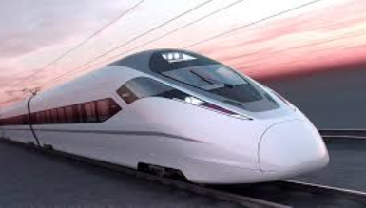
High speed train
Notes:
Role 1 MAZZIOTTI
Did you know that each high-speed train uses about 20 tonnes of copper components: mainly in the voltage transformers (trasformatori elettrici)and in the drive motors (motrici)
The pantographs (pantografi) of high-speed trains place huge forces on the overhead wiring systems (catenaria) that supply electricity.
(puni non dire questa frase sotto)
Special copper alloys have been developed to maintain the required contact as train speeds continue to increase.

Slide 21
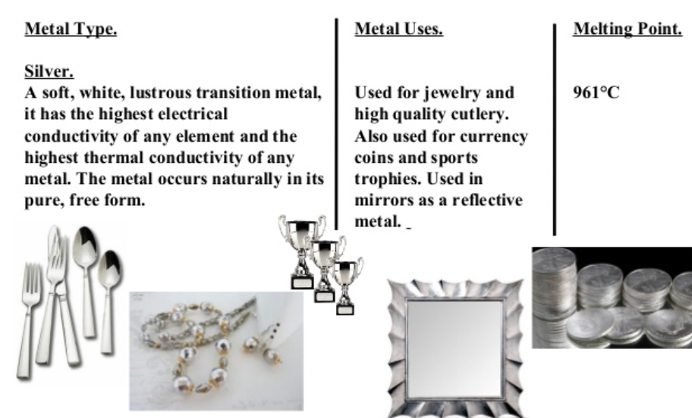
Non ferrous metal:silver
Notes:
Role 1: ANGELO MA
Silver is another non ferrous metal and it is very precious
It is very soft and shiny
it’s main characteristic is that is its electrical and thermal conductivity
It’s mostly used for jewellery pieces as well as precious cutlery for the snobbish people

Slide 22
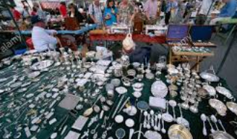
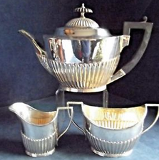
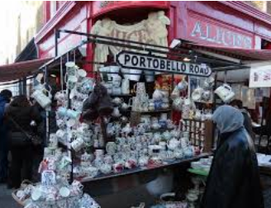
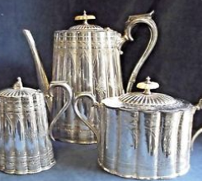
Portobello market - london
Notes:
Role 1 AZ
My English teacher is mad for silverplate tea pot sets. She is an antique collector.
She explained us that the first silverplate tea and coffee pots were made of Sheffield silver, which describes an English plating technique developed in the 1740s,
THIS TECHNIQUE CONSISTS OF sheets of sterling silver fused to sheets of copper, creating a strong, bi-metal “sandwich” that could be formed and chased (modellato) just like sterling silver (l’argento puro).
(poi non dire questa frase)
About 100 years later, also in England, electroplating was introduced. It required even less silver, which meant silverplate tea sets and the like could be marketed to the country’s emerging middle class.

Slide 23
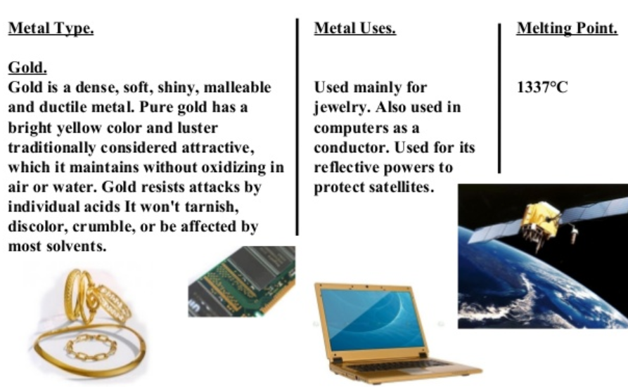
Non ferrous metal: gold
Notes:
Gold – oro
Role 1: QUATTROCIOCCHI
The most expensive metal that we all know is: gold
it is very shiny and makes most women happy !!!!!
Pure gold is so soft that you can shape it with your hands.
It is very malleable and ductile too, which is why most gold jewellery alloys actually contain a mixture of gold, silver and copper.
Even twenty-four carat gold contains some copper!

Slide 24
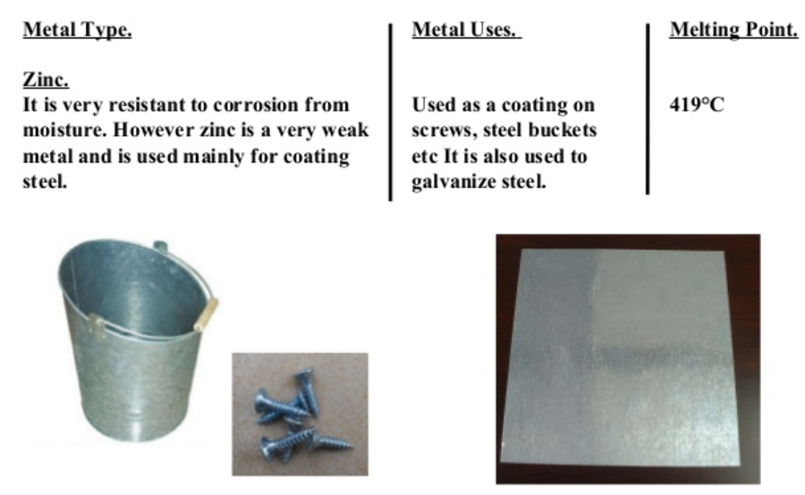
Non ferrous metal: zinc
Notes:
Role 1: ANGELO MA
This is another non ferrous metals: ZINC which is
Very resistant to corrosion That is why It’s used for coating steel (rivestire oggetti d’acciaio)
Most common nails (chiodi) are in zinc

Slide 25
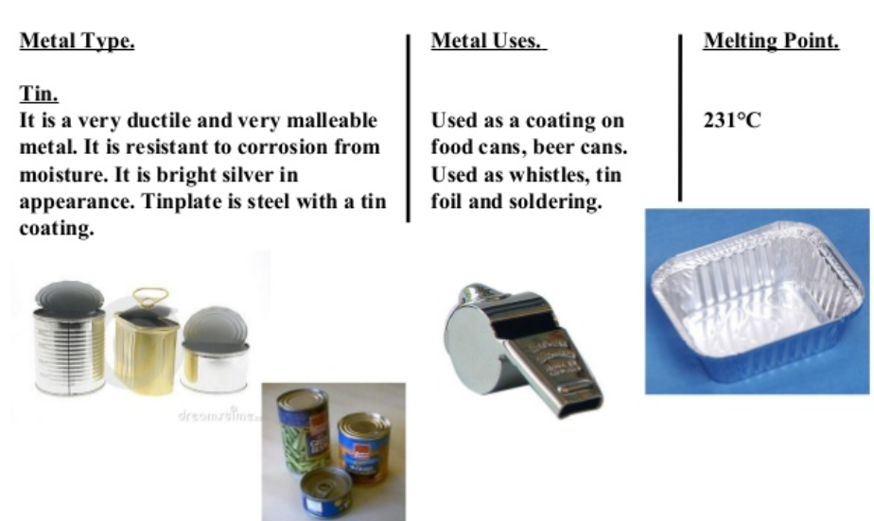
Non ferrous metal: tin
Notes:
Tin – stagno
ZONARELLI
To conclude: Tin Is the most common and the cheapest non ferrous metal
It is Extremely malleable, resistant to corrosion, very bright as much as silver ! But defenitely less expensive than silver !

Slide 26
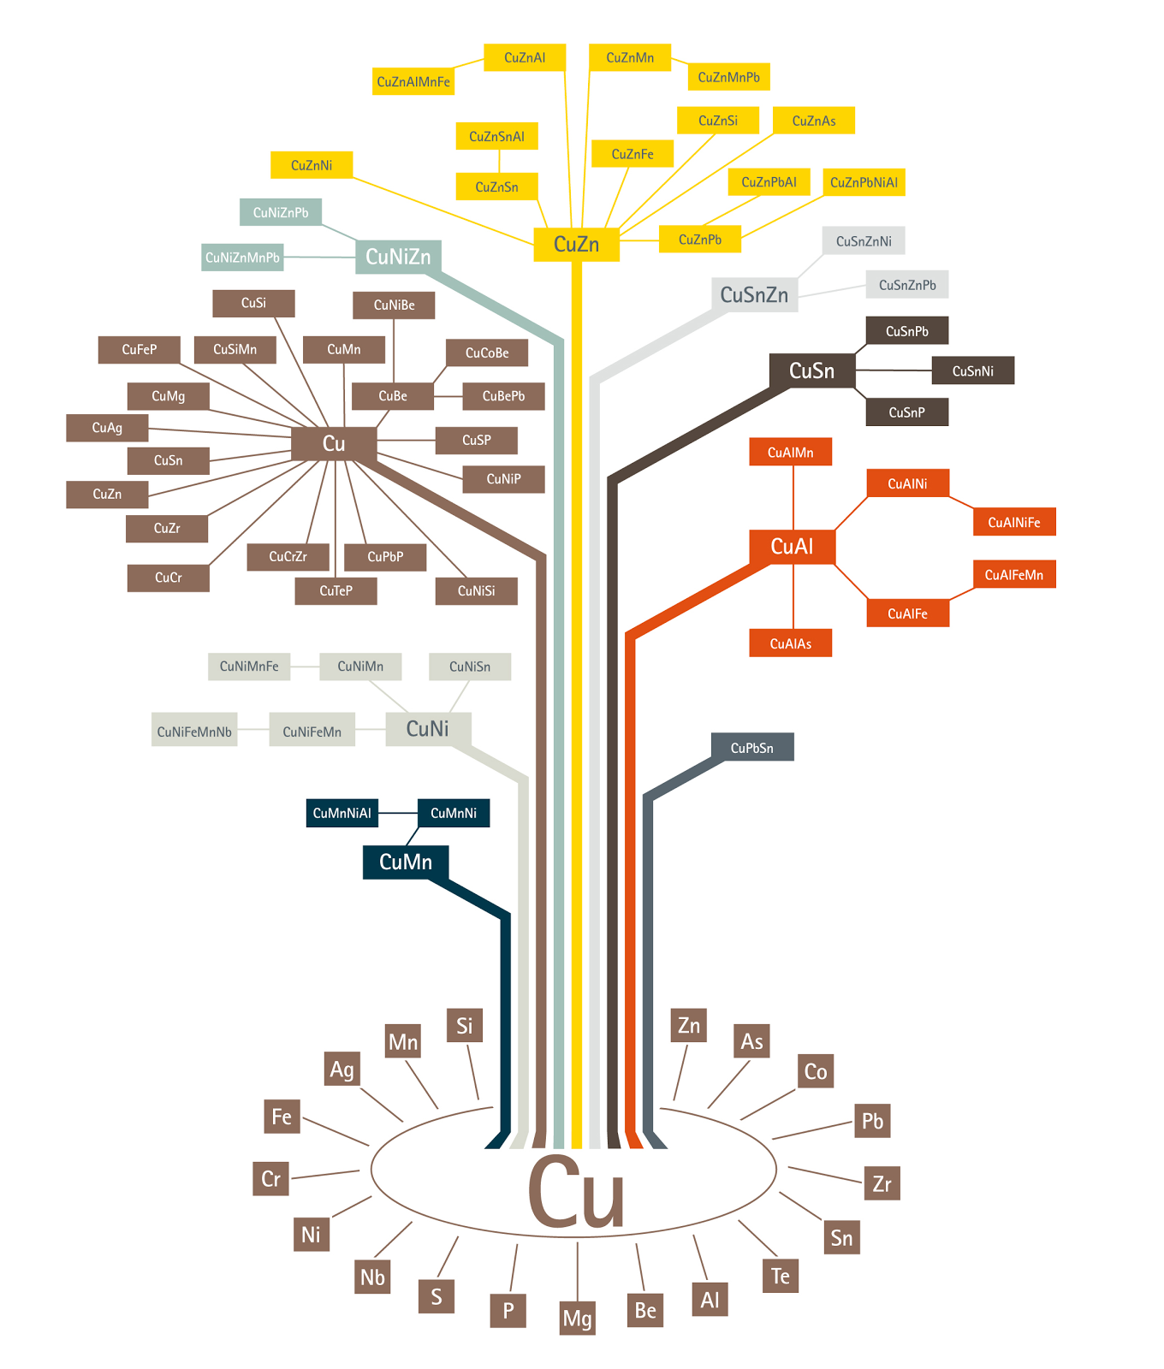
Copper alloy tree
400 copper alloys
user friendly for the environment
Notes:
Role 1 ROSOLINI
This tree is the so called copper alloy tree which tells us that There are more that 400 copper alloys !!!
Each one with its inner quality, good to be used for several productive processes and user friendly for the environment.
(Ci sono più di 400 leghe di rame, ognuna con la sua unica combinazione di proprietà, per rispondere ad una determinata applicazione, processo produttivo e ambiente.)

Slide 27
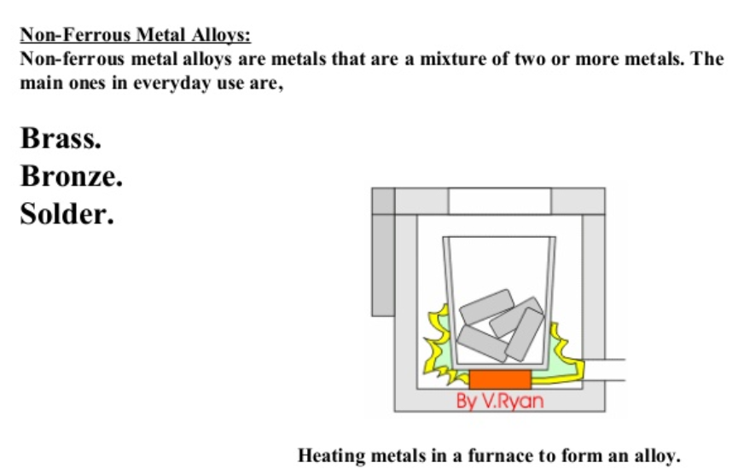
Non ferrous alloys
Notes:
Role 1: ZONARELLI
The most well known metals which belong to non ferrous alloys are: brass (ottone) , bronze (bronzo) and solder.
The most common objects in brass are : the handles of he doors that we have in our homes
Most statues that we can admire in the streets are made of bronze

Slide 28
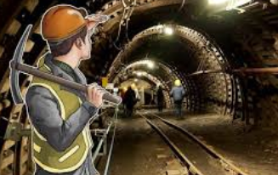

A new kind of mining
Notes:
Role 1: TONELLI
Thanks to the participation to ECOMONDO FAIR , we have acquainted Gruppo Mirafiori
Since the 1950’s this group has been collecting, processing and suppling recycled metals to industry.
Role 2: ZONARELLI
Actuallu, They purchase: ferrous and non ferrous materials, but also swift and safe industrial demolitions, as well as they collect and dispose lead batteries.
Role 3: ROSOLINI
I happen to know that Gruppo Mirafiori is headquartered in Bologna and that they have two facilities : one in Rome and one in Bologna.
Role 1: ZONARELLI
Ehi how lucky we are to have this factory in our Region !
Role 2: Did you know that their customers are from premier Italian companies operating in the iron and steel and metallurgic industry.
But they also have customers from all over the world !
Role 3: Through recycling we can still grow, by being green ! Therefore this factory is a golden opportunityto expand the marketby respecting and saving our planet

Slide 29
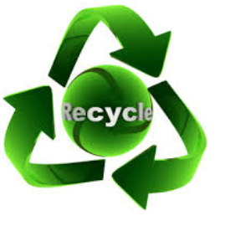
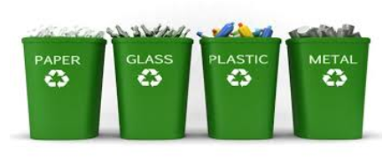

Re-cycling
Notes:
Role 1: VENTURI O ZAPPOLI
If we re-use metals as well as other materials, we reduce waste, THAT I S WHY the most modern and environmentally friendly industries recycle them !!!
Role 2: ZONARELLI
AMONG ALL METALS copper TOGETHER WITH ALUMINIUM ARE the best recycled metaLS
it has been estimated that at least 80% of all copper ever mined is still in use or available for use
Today, around 40% of Europe’s demand for copper is met by recycled material.

Slide 30
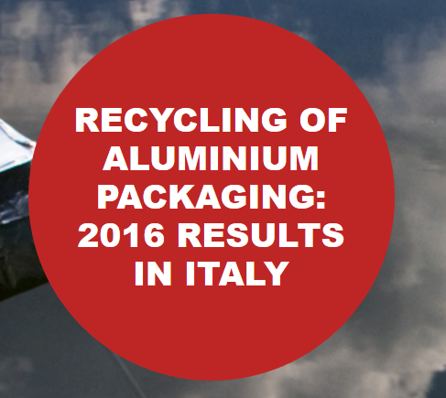
Separate collection, recovery and recycling of aluminium packaging.
Avoid the emissions of 369million tons of greenhouse gasses (CO2)
Save over an equivalent of 159milliom ton of oil (pretrolium)
48,700 tonnes of aluminium packaging → recycled
927 tons of aluminium waste → recycled
Notes:
Role 1 TONELLI
Thanks to the re-cycling of 49 million tons of aluminium packages in 2016
It has been possible to :
Avoid the emissions of 369million tons of greenhouse gasses (CO2)
Save over an equivalent of 159milliom ton of oil (pretrolium)
Role 2 ZONARELLI
Ciai is the Italian national consortium in charge of recycling aluminum packaging collection from Italian municipalities through separate collection of municipal waste.
Role 3: CARASSITI
Ciai launched in 2016 a campaign for the collection, recovery and recycling of aluminium packaging
The 2016 was a very positive year
Role 4 GALEOTTI
If you are good at Maths, note some interesting numerical data
A total of 48,700 tonnes of aluminium packaging was recycled,
Role 5 ROSOLINI
The total quantity of aluminium waste recycled in 2016 was 927 tons.
This result was made possible by the participation of citizens and agreements reached between CIAL and local authorities.

Slide 31
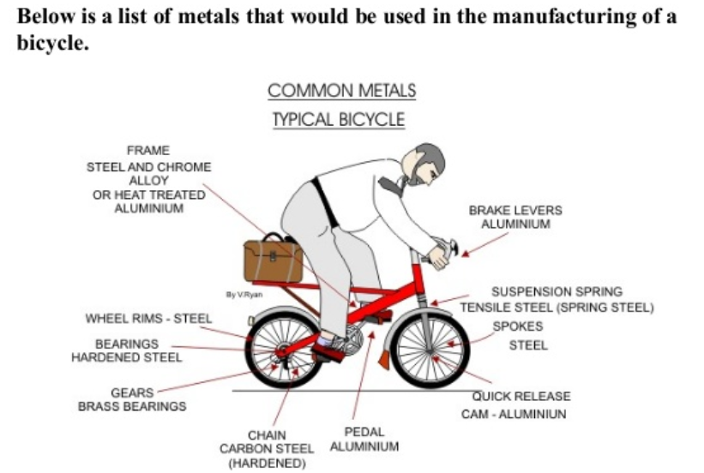
Re-cycle bike
Notes:
Role 1 CAMPOLI O FANTI
Modern bikes are mostly made of recycled aluminium which make them very light and practical
Nowadays a high percentage of people use bikes to move around town.
The benefits are several and to name but a few:
it’s good for people’s health
It helps to keep the planet green and save it
(Inquadratura dei ragazzi che se ne vanno in bicicletta con i docenti)

Slide 32
teachers
English Teacher Abate Alessandra (Clil)
Science teacher Bonfatti Elisabetta
Science Teacher Conte Franca
Art Teacher Catelli Marco
Science Teacher Notari Stefano Carmela
Notes:
Role 1: CAMPOLI GIULIA
We thank our teachers who have helped us to work on this scientific topic in an innovative and appealing way, that is to say by taking us to a Fair and also in a foreign language.
NELL’AMBITO DEL PROGETTO
LA PERFETTIBILITA’ DELLA DIDATTICA DELLE SCIENZE NATURALI IN LABORATORIO ED IN AULA

Slide 33
students
ATOKO OSHIORAME ROBERTO BALLARINI FEDERICA BORTOLOTTI CATERINA BRUNI LEONARDO CALLEGARI BEATRICE CAMPOLI GIULIA CAMPOLI VERONICA MURIEL CARASSITI MARTINO ELIA MARTINA FANTI SIMONE FOLI MATILDE GALAZZI GIULIO GALEOTTI FABIO GHAZANFAR ALISHBA HAMWI SARA IACCARINO FABIO KARAEV AZNAUR MA ANGELO MAZZOTTI SERENA MINGHINI MARTINA QUATTROCIOCCHI CAMILLA ROSOLINI LEONARDO ROSSI TIZIANO TONELLI CATERINA VENTURI SAMUELE ZAPPOLI ENRICO ZONARELLI GIOVANNI
Notes:
ALUNNI
NOMINATIVI
ATOKO OSHIORAME ROBERTO BALLARINI FEDERICA BORTOLOTTI CATERINA BRUNI LEONARDO CALLEGARI BEATRICE CAMPOLI GIULIA CAMPOLI VERONICA MURIEL CARASSITI MARTINO ELIA MARTINA FANTI SIMONE FOLI MATILDE GALAZZI GIULIO GALEOTTI FABIO GHAZANFAR ALISHBA HAMWI SARA IACCARINO FABIO KARAEV AZNAUR MA ANGELO MAZZOTTI SERENA MINGHINI MARTINA QUATTROCIOCCHI CAMILLA ROSOLINI LEONARDO ROSSI TIZIANO TONELLI CATERINA VENTURI SAMUELE ZAPPOLI ENRICO ZONARELLI GIOVANNI

